Slide 1
Exercise Univariate Analysis with Metabox
Sili Fan WCMC statistician

Slide 2
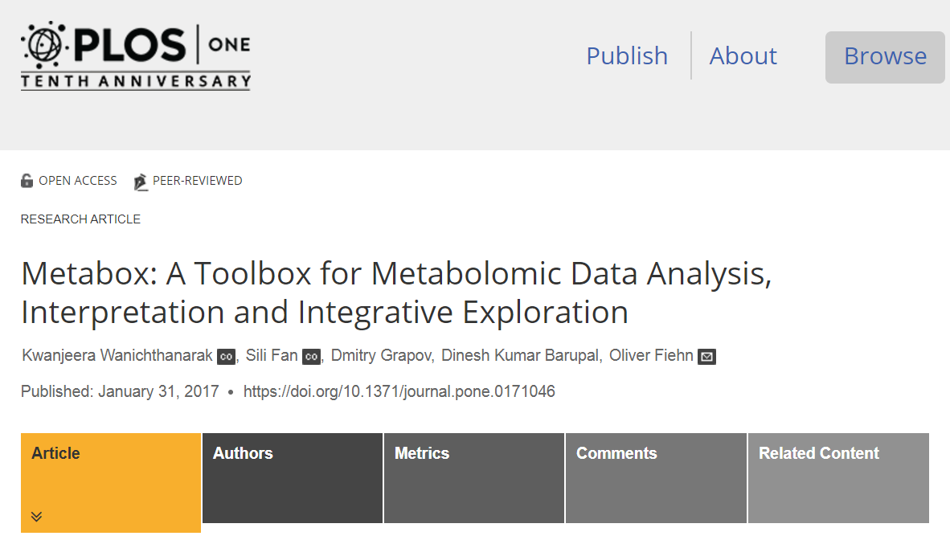
MetaBox online
metda.fiehnlab.ucdavis.edu
Power analysis
*local
https://github.com/slfan2013/metabox.stat

Slide 3
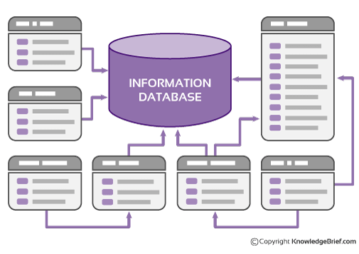
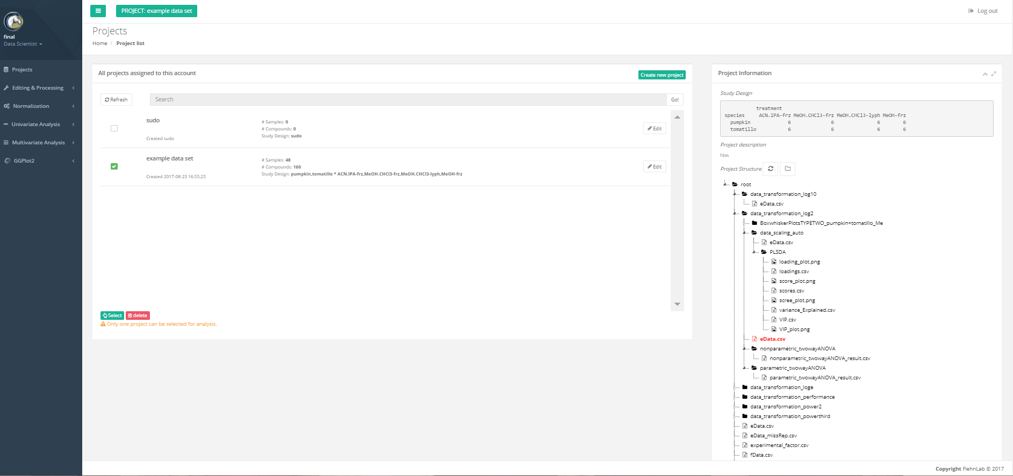

Slide 4
Lets start by downloading the data
https://github.com/slfan2013/summer-course-2017

Slide 5
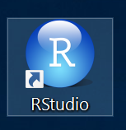
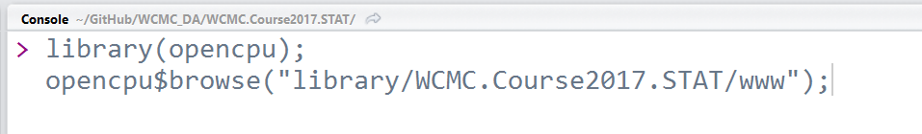
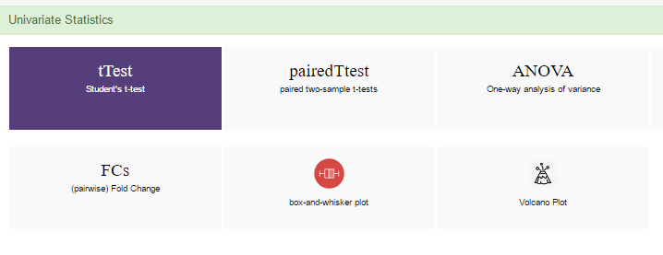
Launch MetaBox locally
Open Rstudio:
2. copy + paste:
library(opencpu); opencpu$browse("library/WCMC.Course2017.STAT/www");
to the console.
3. Start analyzing:
For more information: https://github.com/slfan2013/WCMC_DA

Slide 6

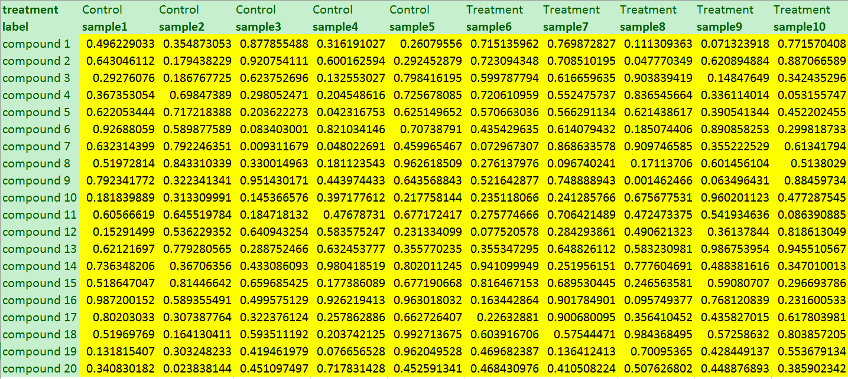
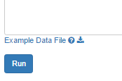
t test
Input format
Different module may have different input format.
Row & column order matters.

Slide 7
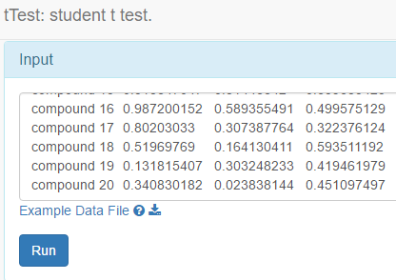
t test page
Click Run

Slide 8
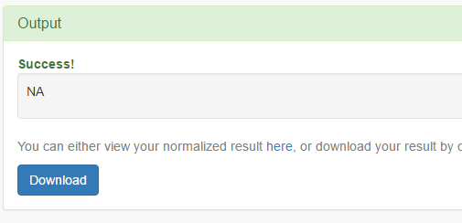
t test
Click Download

Slide 9
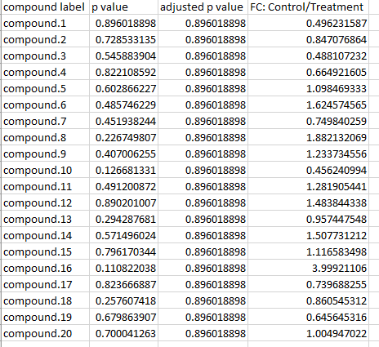
t test
output

Slide 10

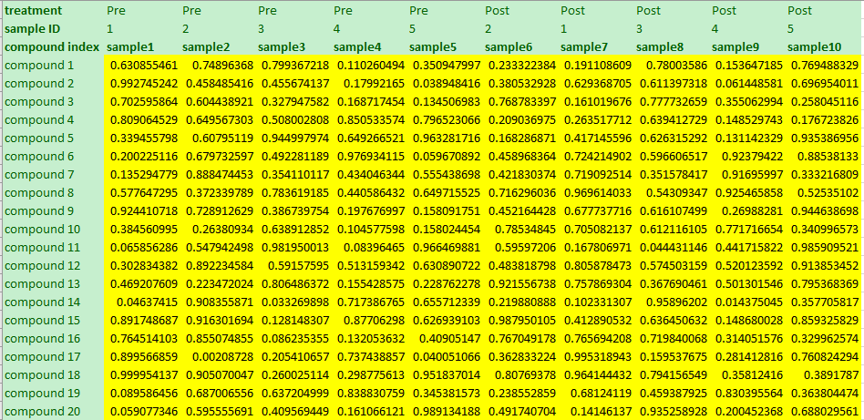
paired t test
Input format
sample ID is critical for paired studies, including paired t test, repeated ANOVA and mixed ANOVA.

Slide 11

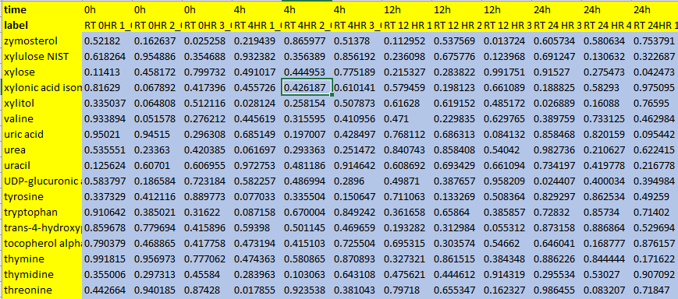
pair-wise fold changes
Input format
4 factors → 3+2+1 pairs of fold change

Slide 12
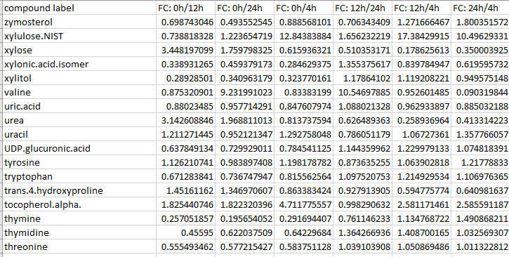
pair-wise fold changes
output
Be careful with the direction

Slide 13

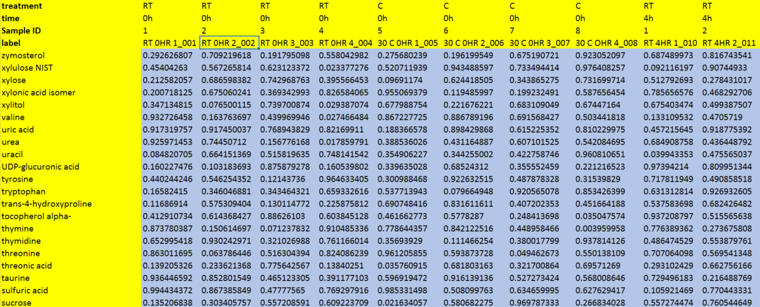
Two-way Mixed ANOVA
Input format
sample ID is critical for paired studies, including paired t test, repeated ANOVA and mixed ANOVA.

Slide 14
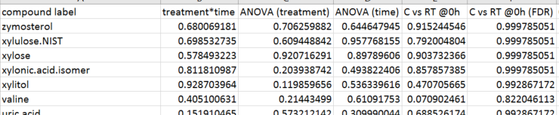
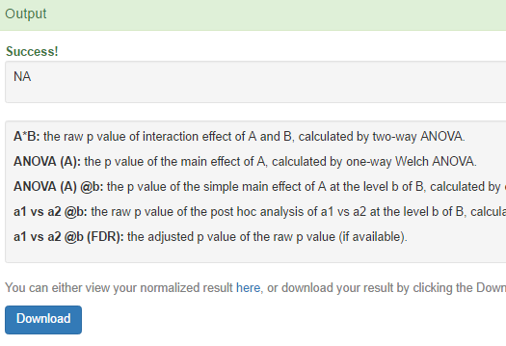
Two-way Mixed ANOVA
output
Main effect
interaction
Simple main effect

Slide 15

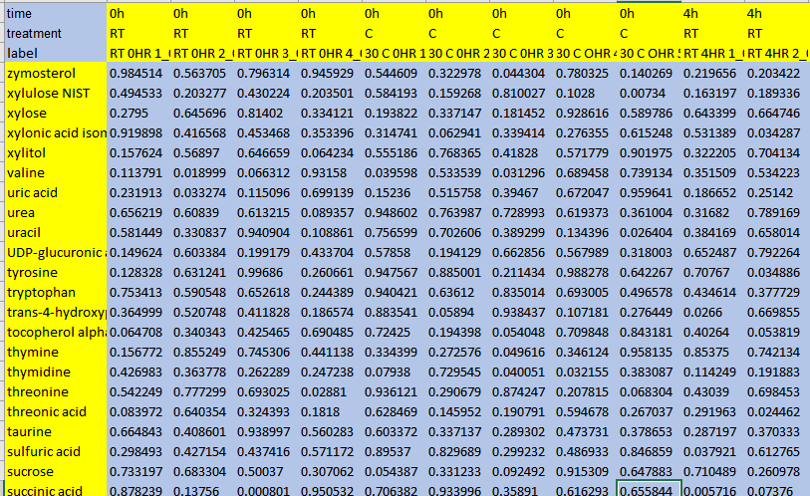

boxplot
Input format
Factor 1
Factor 2

Slide 16
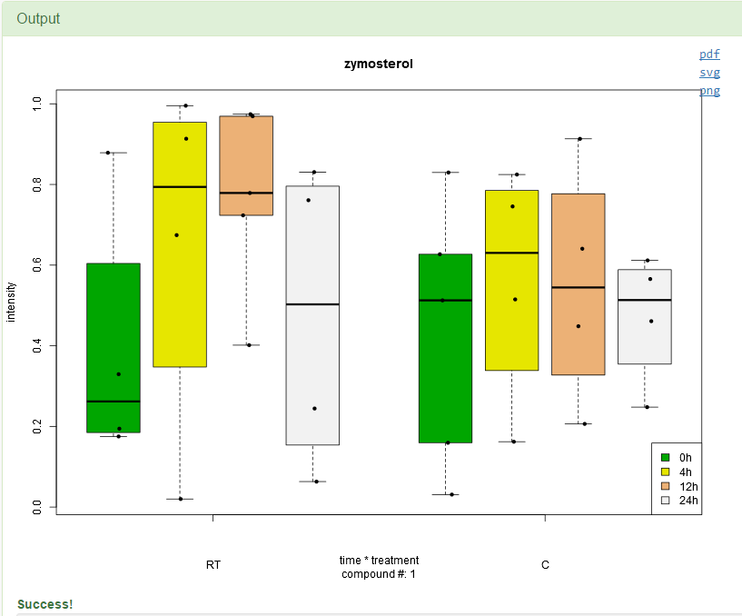
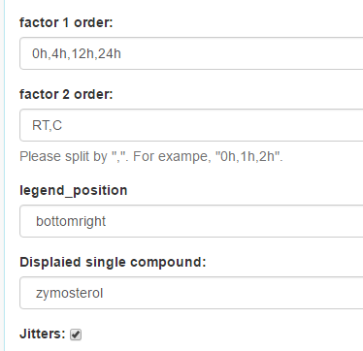
boxplot
output

Slide 17
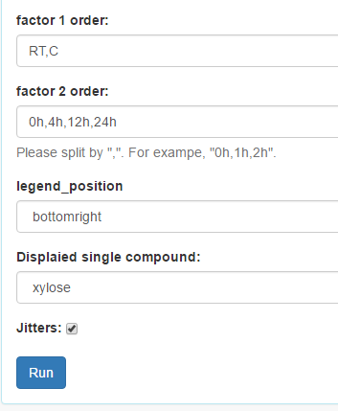
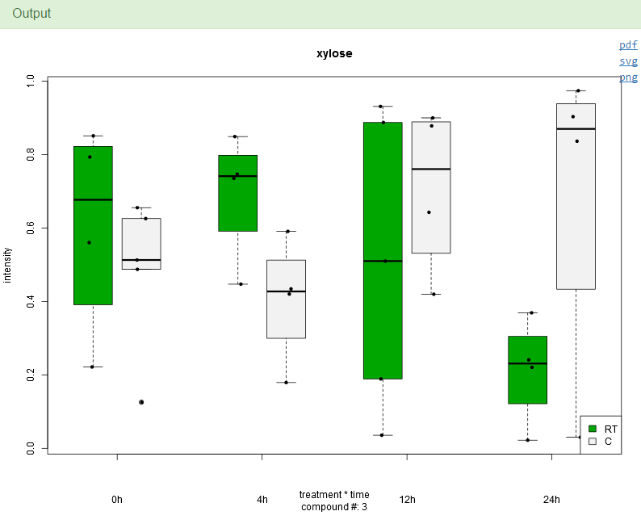
boxplot
output2

Slide 18

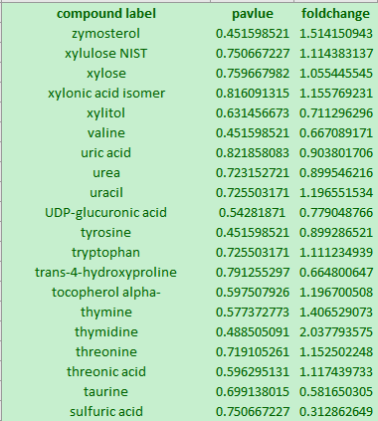
volcano plot
Input format
column order matters.

Slide 19
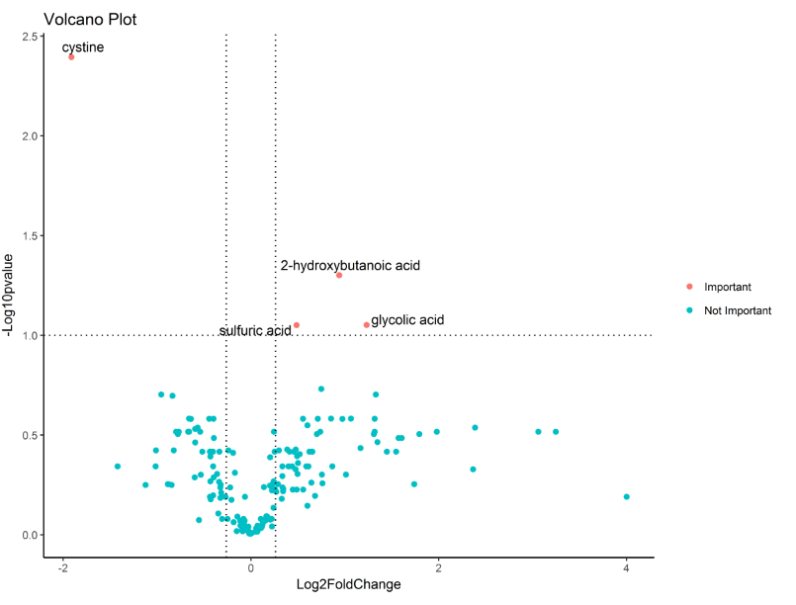
volcano plot
output
High significant
Low
significant
-ve effect
+ve effect

Slide 20
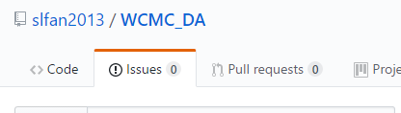
About MetaBox
paper
Wanichthanarak K, Fan S, Grapov D, Barupal DK, Fiehn O. Metabox: A Toolbox for Metabolomic Data Analysis, Interpretation and Integrative Exploration. PloS one. 2017 Jan 31;12(1):e0171046.
source
https://github.com/kwanjeeraw/metabox
https://github.com/slfan2013/WCMC_DA
Recommended
To report bugs or suggestions

Slide 21
Group Exercise
Try to finish following points:
What criterion can we use to decide data pre-processing procedures?
What normalization, transformation and scaling procedure is best?
Which hypothesis testing procedure should I use? Why?
fold change calculation
Visualize data to justify the result.
…
A
B

